Slide 1


Inclusive Education
Building Supporting Systems
Astrid Ebenberger, Vice president
Coface, Graz
Oct. 5th, 2018
ebenberger@familie.at

Slide 2

Towards inclusive education in Austria
Research and development project „English Language Teaching in Inclusive Settings”
Findings, discussion

Slide 3
National Austrian Strategy
Schools for children with special needs by law in 1962
Integration as a principle in the curriculum (1993)
National plan (BAMSK 2012) – for inclusive education:
Creation of model-regions for inclusive education
In-service training for stakeholders and school supervisors as well as monitoring people and teachers.
Abolishment of the separate education of teachers for children with special needs (BMBF 2015a)
General paradigm in schools: Dealing with heterogeneous classes as well as differentiation and individualization in teaching and learning.
Creating material that supports individual development of children e.g. for English language teaching (ELT

Slide 4

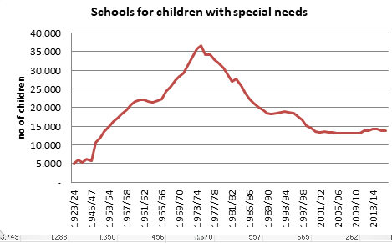
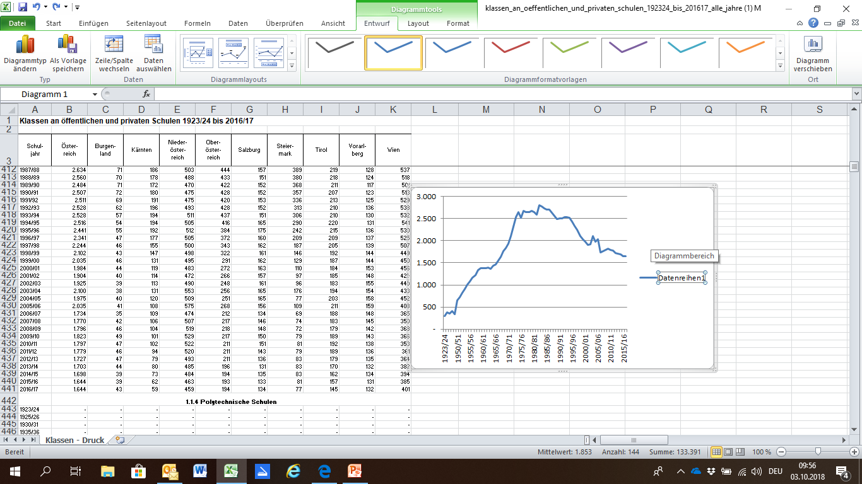
National Strategy
Different definition: Integration - Inclusion
: Classes and numbers of children in schools for special needs

Slide 5
English Language Teaching in Inclusive Settings
Research and development project © A.Ebenberger
  In how far can findings about successful inclusive teaching be transferred into the context of inclusive language teaching?
  Qualitative-empiric research ➔hermeneutic process
Finding I: Successful inclusive teaching depends on the participants
  The school and the teachers
  The children
  The parents

Slide 6
Framework of Inclusion

Slide 7
Index for Inclusion – Dimensions/Sections
School Quality -Inclusion
A)Creating inclusive cultures:
Building community, Establishing values
B) Producing inclusive policy:
Developing the school for all;
Organsing support for diversity
C) Evolving inclusive practices:
Orchestrating learning; Mobilising resources
Figure 2: Booth, T., Ainscow, M. (2002). Index for inclusion

Slide 8

Value – Being a Father
A campaign of Katholischer Familienverband Ö
school
child parent/
mother+father

Slide 9
Thank you!
Your questions, please!

